Slide 1

CAPSTONE PROJECT
STOCK PRICE
PREDICTION SYSTEM
TEAM H
Donghun Jung
Chanyoung Lee
Yujin Seo

Slide 2
Contents
01
02
03
04
05
Project
Objectives
AI Models
& Programs
Challenges
& Progress
Result
& Discussion
Demo

Slide 3
Project Objectives
Stock Price Prediction System
Using AI Models – LSTM, GRU, Transformer
Specialized for sequential data(time series data) analysis
Front-end Implementation
Visualize real and predictive graphs through website development
Not Real-Time

Slide 4

Project Objectives
What is the difference with existing services?
There are already many stock investment services using AI
But they care about the stable distribution and management of assets of the users

Slide 5
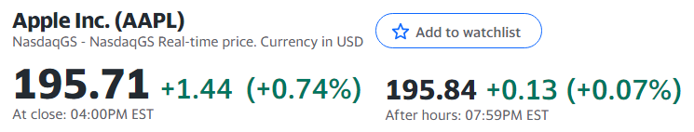
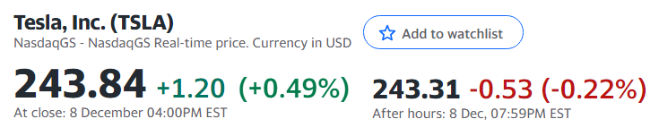
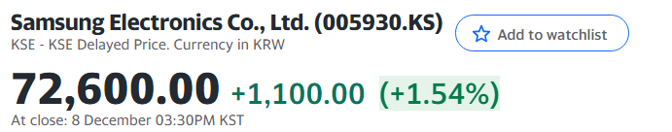
Project Objectives
So, we decided to focus only on improving the predictive performance…
Because it is hard to implement many functions due to the limited cost and time given

Slide 6
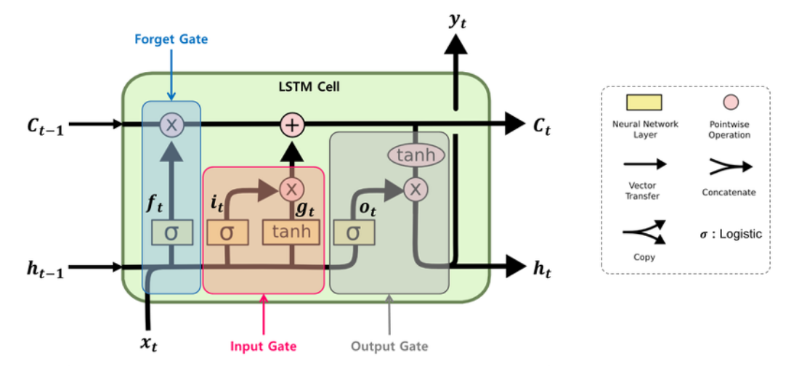
AI Models & Programs
LSTM (Long Short Term Memory)
Solves gradient vanishing problem of existing RNN when input data is too long

Slide 7
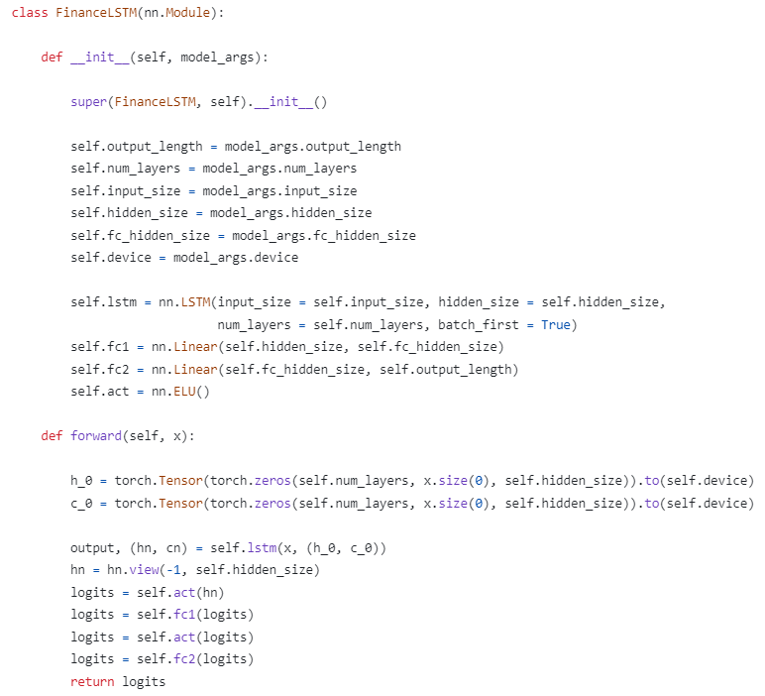
AI Models & Programs
LSTM (Long Short Term Memory)
Solves gradient vanishing problem of existing RNN when input data is too long

Slide 8
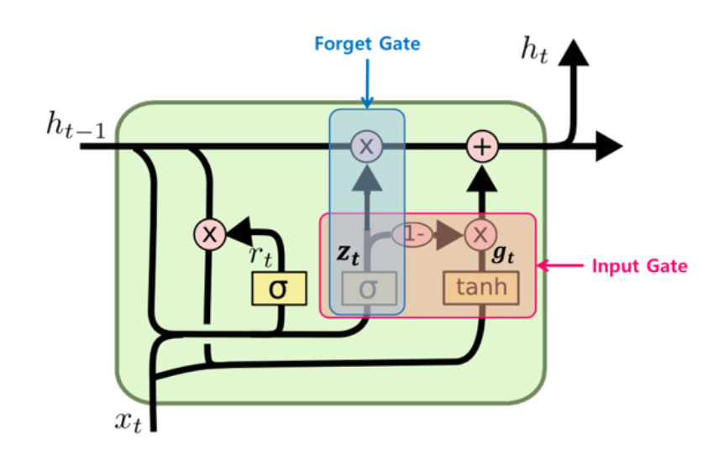
AI Models & Programs
GRU (Gated Recurrent Unit)
A version of simplifying the time-step cell that makes up the LSTM

Slide 9
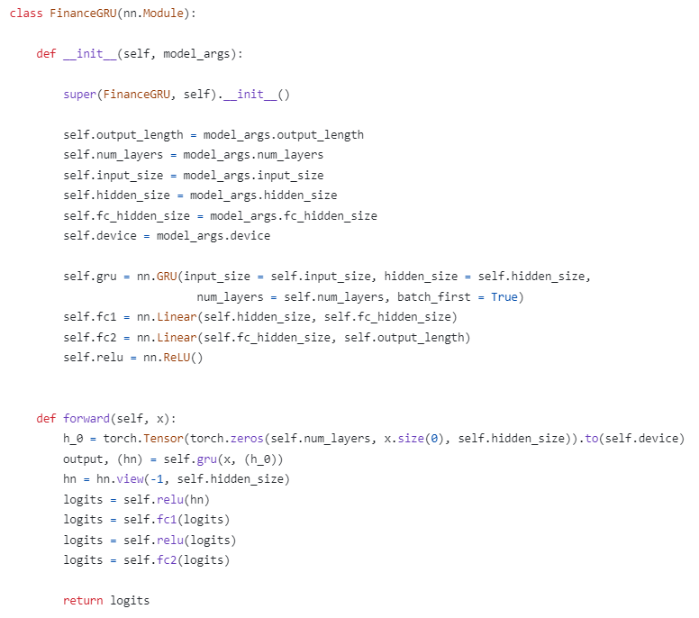
AI Models & Programs
GRU (Gated Recurrent Unit)
A version of simplifying the time-step cell that makes up the LSTM

Slide 10

AI Models & Programs
Transformer
Parallel processing is possible by putting the sequence at once, and location information can be reflected

Slide 11
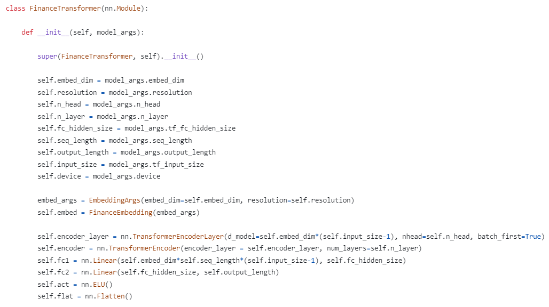
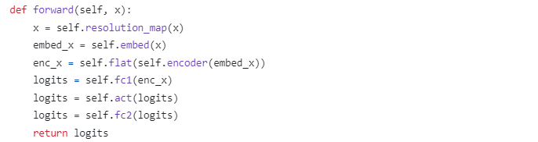
AI Models & Programs
Transformer
Parallel processing is possible by putting the sequence at once, and location information can be reflected

Slide 12



AI Models & Programs
Backend Programs

Slide 13

AI Models & Programs
Frontend Programs

Slide 14
Challenges & Progress
Graph Shifting
: “Tomorrow’s stock price will be Today’s stock price”

Slide 15
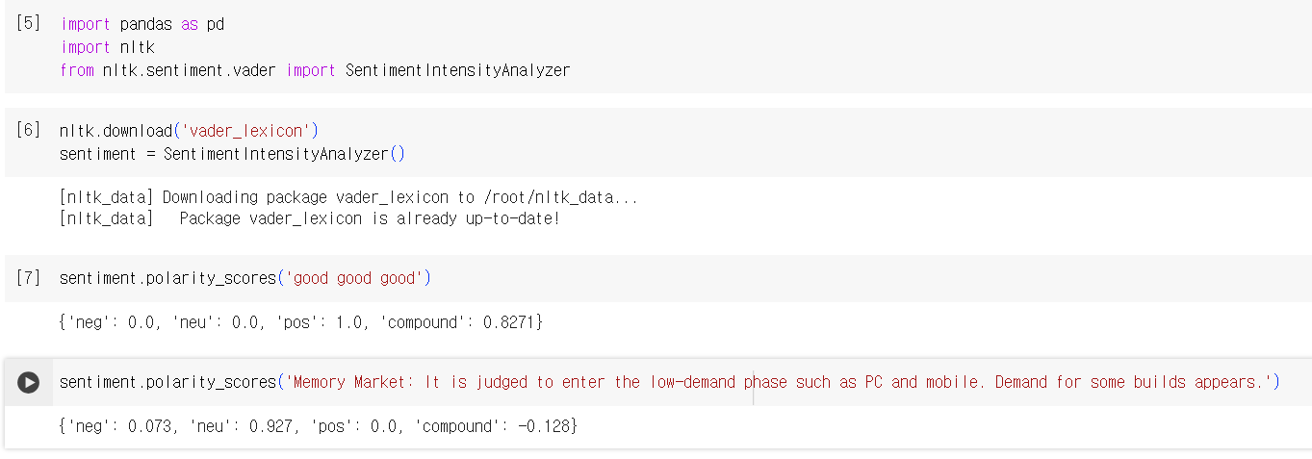
Challenges & Progress
Problem: Graph Shifting
💡 Solution: Apply more diverse features to predictions
👉 Progress: Apply VADER score of stock market articles

Slide 16
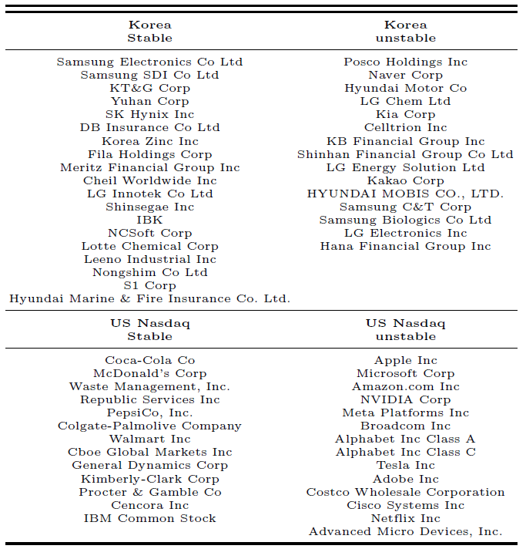
Challenges & Progress
Problem: Graph Shifting
💡 Solution: Train models with another stock data
👉 Progress: Increase the dataset and divide it into 4 categories

Slide 17
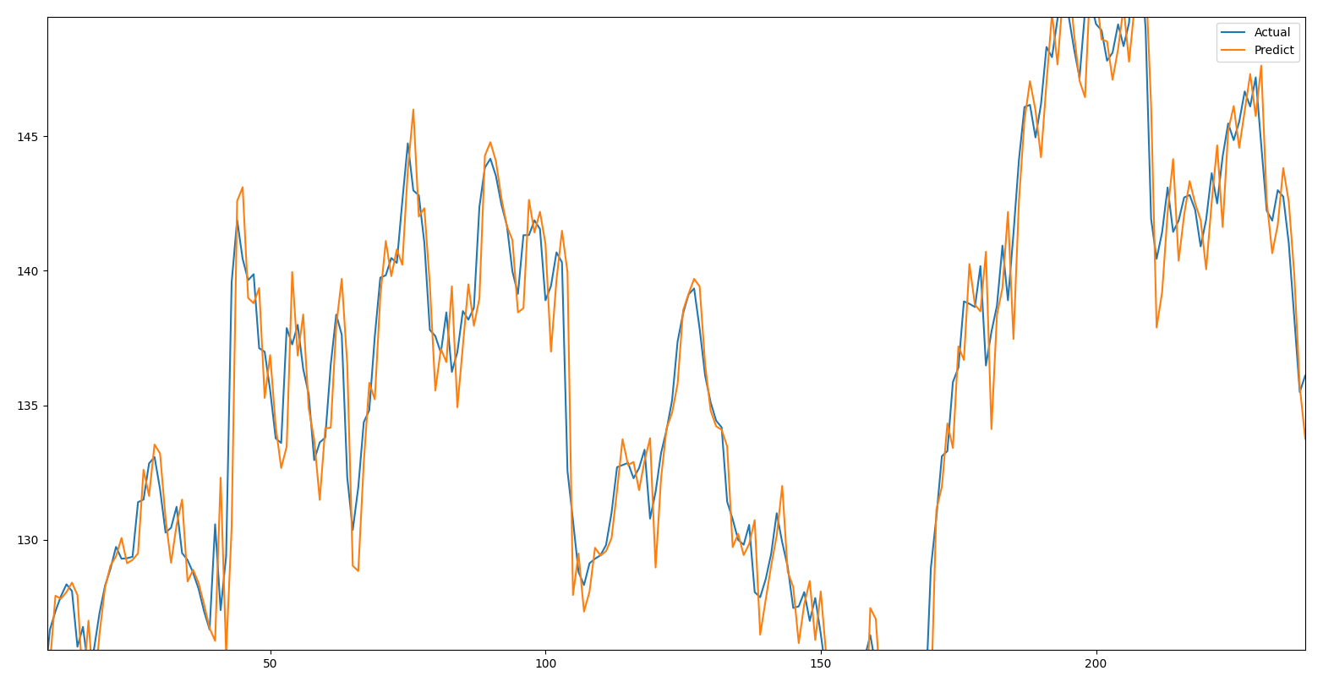
Challenges & Progress
Problem: Graph Shifting
💡 Solution: Make some changes in the learning rate of the models
👉 Progress: Apply learning rate scheduler to prediction system

Slide 18
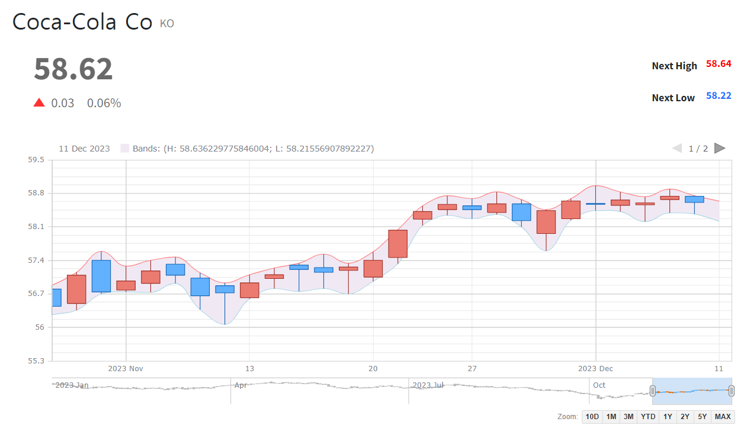
Demo
Stock Name
Next Stock Price (Prediction)
Tomorrow changes
(Prediction)

Slide 19
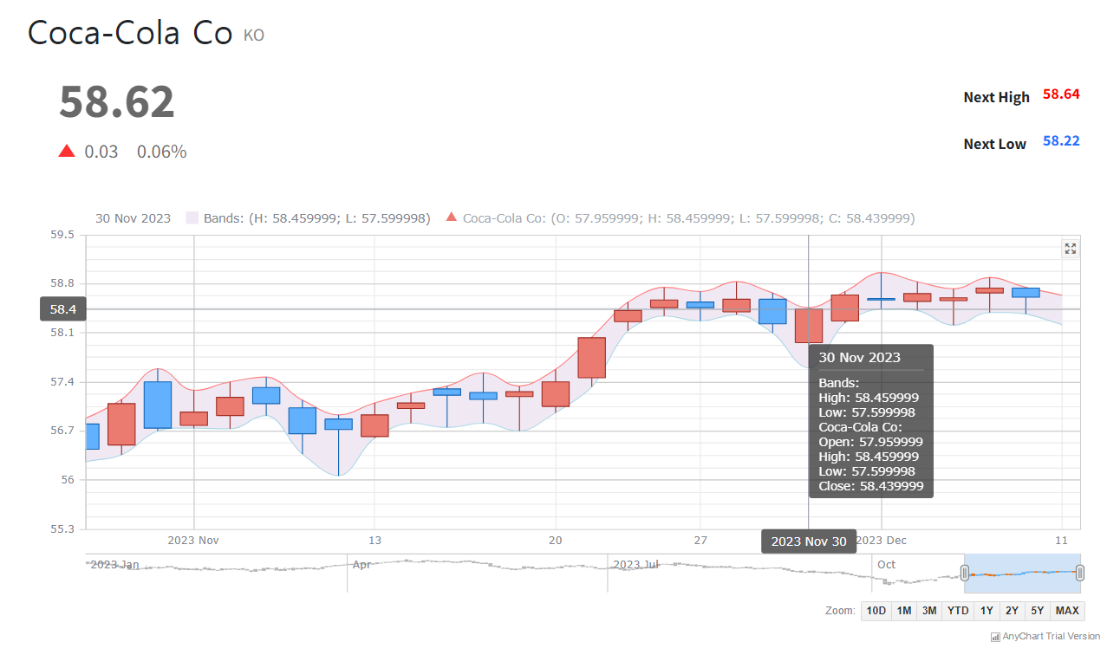
Demo
Stock price visualization
with candle chart
Prediction range: high - low
Stock information
for each date

Slide 20
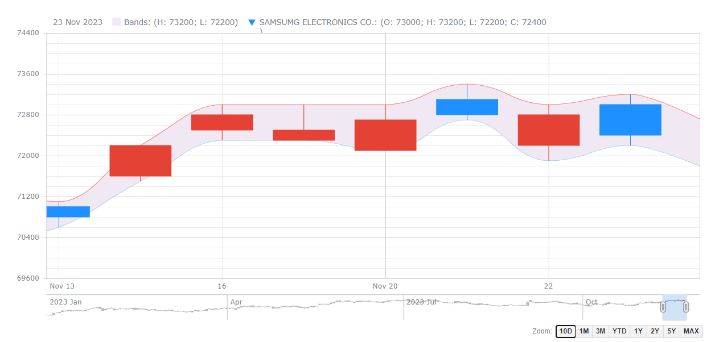
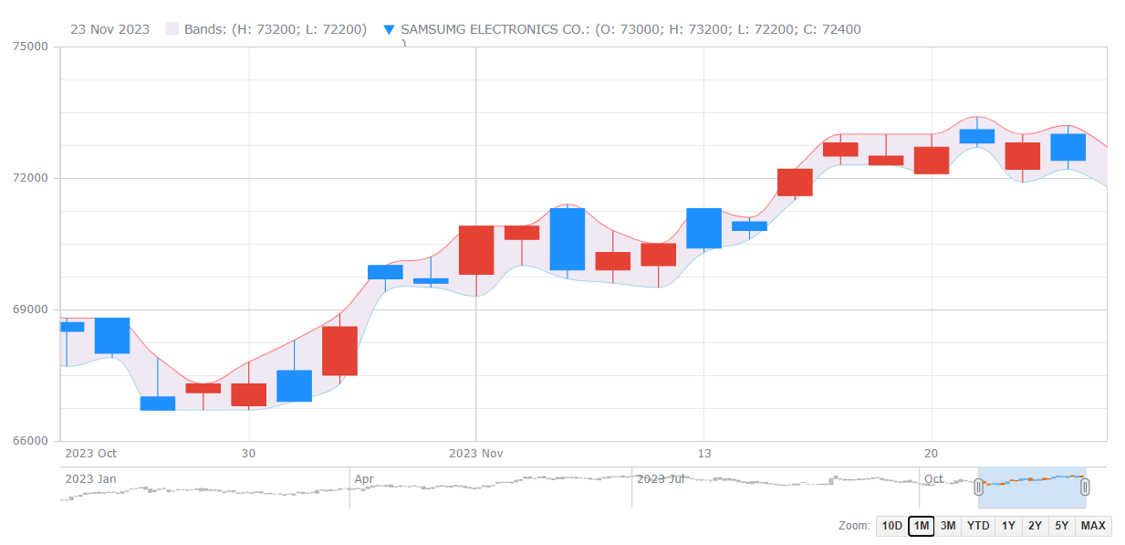
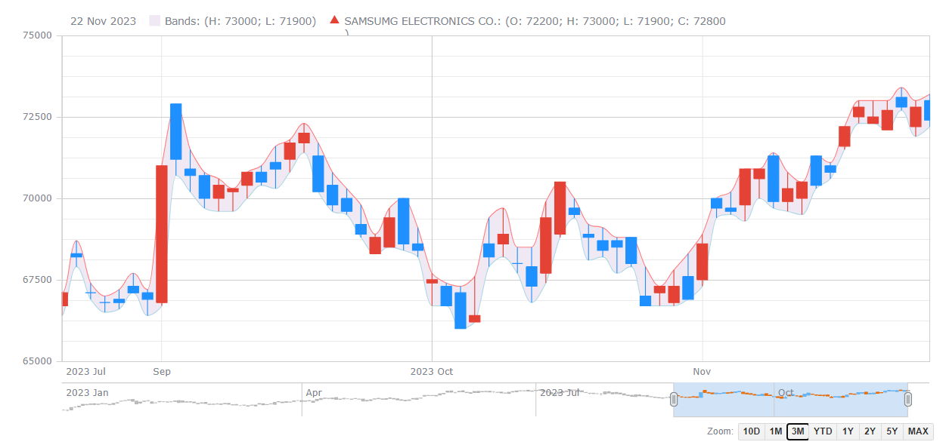
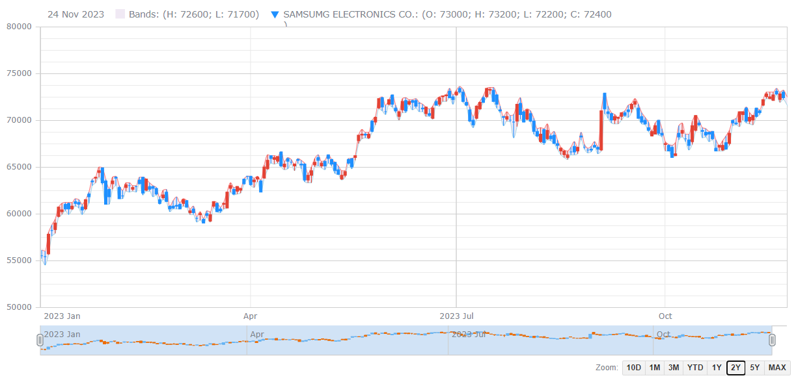
Demo
Period: 10 days
Period: 1 month
User can select the period with buttons or time scrollbar
Period: 3 months
Period: 2 years

Slide 21
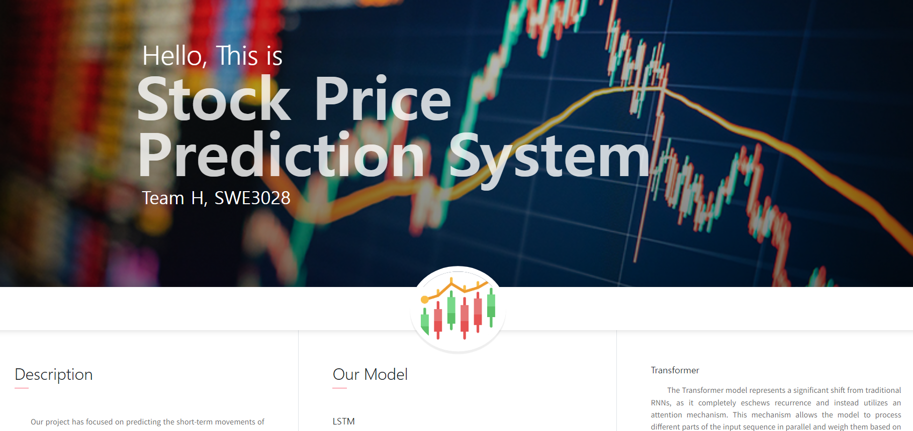
Demo
http://3.34.75.210:8000/
We recommend you to use the website with laptop

Slide 22
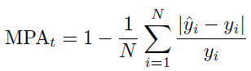
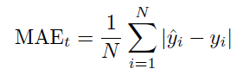
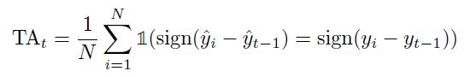
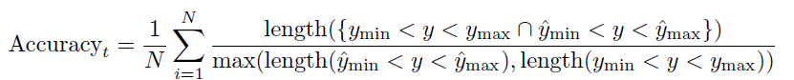
Result & Discussion
Accuracy measurement method
MPA & MAE: Evaluate the effectiveness of our methods
TAC: Focus on short-term stock price trends
Accuracy: Compare the similarity between the predicted and actual price intervals

Slide 23
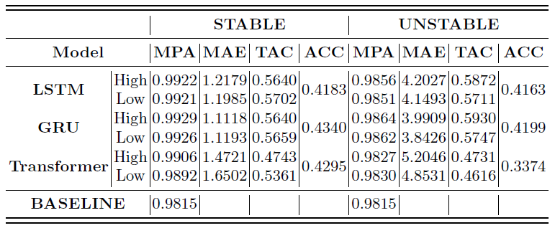
Result & Discussion
Performance of our models on the test set is quantified.

Slide 24
Result & Discussion
Our prediction system has resulted in MPA surpassing that of the baseline model (DP-LSTM).
It seems that our progress has the effect of increasing prediction accuracy.

Slide 25
Result & Discussion
The model’s performance varies based on the stability of the stocks. For unstable stocks, the MAE significantly increases, and ACC decreases.

Slide 26
Result & Discussion
Both LSTM and GRU models exhibit similar performance metrics, whereas the Transformer model has relatively lower performance.

Slide 27
Result & Discussion
Limitations: Prediction Quality
Increased inaccuracies for specific cases
Problem arises when the stock price remains relatively constant with minor fluctuations (2023-11-16 to 2023-12-01)
In the case of Transformers, the high-priced and low-priced sections are uneven

Slide 28
Result & Discussion
Limitations: Lack of Information
Imbalance of news articles
Famous stocks have a lot of related information, but obscure stocks update less and slower
Articles written in a limited period of time
The referenced news site's articles are limited to maximum 1,000 per stocks

Slide 29
Roles
Donghun Jung
Chanyoung Lee
Yujin Seo
- AWS server build
- UI/UX Design
- Backend Implementation
- Documentation (Proposal, Final)
- LSTM Development
- Transformer Development
- Model Improvement
- GRU Development
- VADER Development
- Collecting Stock News

Slide 30
Time Table
 | Week 03 | Week 04 | Week 05 | Week 06 | Week 07 | Week 08
Donghun Jung | Proposal |  | AWS Server Build | AWS Server Build
Chanyoung Lee | LSTM Development |  |  | Model Improvement
Yujin Seo | GRU Development |  |  | Search Paper and Research
 | Week 09 | Week 10 | Week 11 | Week 12 | Week 13 | Week 14 | Week 15
Donghun Jung | UI/UX Design |  | Backend Implementation |  |  |  | Report
Chanyoung Lee | Transformer Development |  | Hyperparameter Tuning |  | Testing |  | Final Testing
Yujin Seo | VADER Development | VADER Development |  |  | Collecting Stock News

Slide 31

Any Question?

